Slide 1
How to organize and reveal the knowledge in digital resources of cultural heritage?
-- A case study of Dunhuang Grottoes
Xiaoguang Wang, Wanli Chang, Hongyu Wang
School of Information Management
Wuhan University, Hubei, China
wanghongyu@whu.edu.cn
JCDL 2019 Workshop 3, June 6

Slide 2
CONTENT
Introduction
01
Graph Model Construction
02
Data Process & Result
03
Conclusion & Future Work
04
02

Slide 3
01
Introduction
PART ONE

Slide 4
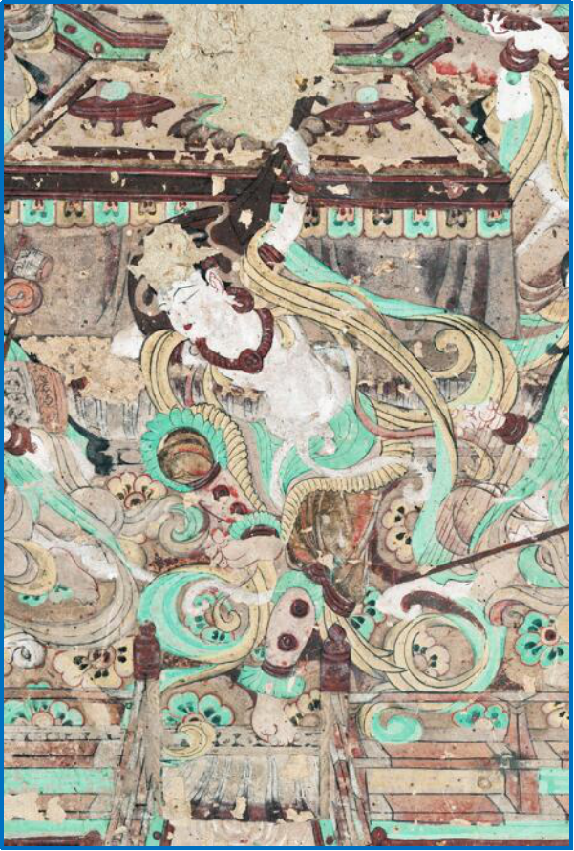
1. Introduction——Background
Cultural heritage carries abundant cultural connotation and knowledge.
With the development of digital technologies, amounts of digital resources has been accumulated in the field of cultural heritage.
Digital resources of cultural heritage have brought a data-driven research pattern to humanists named DH.
Advancing the research in digital humanities (DH) becomes a new mission of libraries, so as to provide high-quality digital resources and their relevant tools for C/O/A/U.
Hongyu Wang , School of Information Management , Wuhan University
04
Notes:
文化遗产承载着丰富的文化内涵与人类知识。
随着大数据、摄影测量(photogrammetry)等数字化技术的发展，文化遗产领域积累了广泛的数字资源。
这些多源、异构、多模态的文化遗产数字资源，为人文学者带来了数据驱动的研究范式，并催生了数字人文这一新兴的交叉研究领域。
推动数字人文的发展，为人文学者提供高质量的数字资源及相应的加工/组织/检索/利用工具，成为了图书馆新的使命。

Slide 5
1. Introduction——Question
In the context of DH, the discovery and revelation of knowledge implied in cultural heritage, through the semantic and expandable organization of digital resources, will efficiently improve the inheritance, application and protection of cultural heritage.
As two commonly used KOS, metadata framework is inefficient in representing and reflecting relationships between knowledge units, and while, ontology model and/or RDF can reflect such relationships but are inability to qualify their instances.
In addition, when adding and associating new kinds of resources, the ontology model needs to be redesigned, so that the knowledge cannot be extended conveniently and efficiently.
Hongyu Wang , School of Information Management , Wuhan University
05
Notes:
在数字人文的背景下，对文化遗产数字资源进行语义化、网络化、可扩展化地组织，完成对文化遗产中所含知识的发现与揭示，将有效促进文化遗产的传承、利用与保护。
作为常用的两种知识组织系统，元数据框架无法有效地表示和反映知识单元间存在的关系，而本体模型和RDF虽然可以反映这种关系，但却无法修饰关系的实例。
此外，当添加和关联新一类的资源时，需要重新进行本体模型的设计，以致于无法便捷、高效地对知识进行扩展。

Slide 6
1. Introduction——Our Work
This paper proposes an attribute graph model according to the characteristics of digital resources of Dunhuang, and constructs a platform of knowledge discovery and revelation by knowledge graph, which organizes, links and stores the domain knowledge contained in these digital resources semantically.
We provide a novel method and example for the knowledge organization and analysis in digital resources of cultural heritage.
DH
Hongyu Wang , School of Information Management , Wuhan University
06
Notes:
本文根据敦煌数字资源的特点，提出了一种属性图模型，并利用知识图谱构建了一个知识发现与揭示平台，对敦煌数字资源中包含的领域知识进行语义化地组织、链接和存储。我们为数字文化遗产资源的知识组织和分析提供了一种新的方法和实例。

Slide 7
02
Graph Model Construction
PART TWO

Slide 8
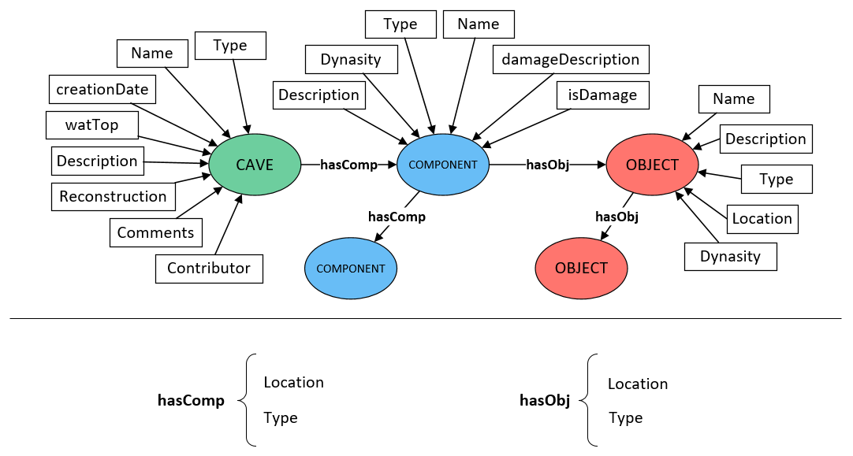
2. Graph Model Construction
The KO model of Dunhuang grottoes based on attribute graph is the basis of knowledge integration and the premise of semantic revelation of digital resources.
Dunhuang Grottoes and cultural elements therein are complicated in structure. For example, Grotto No.61 consists of an arch and a main room with four walls, which each wall contains various objects of cultural elements. Therefore, the relevant resources and elements are divided into three types according to the website of e-dunhuang and related metadata standards in this paper. Finally, we built the following KO model.
Hongyu Wang , School of Information Management , Wuhan University
08
Notes:
基于属性图构建敦煌石窟知识组织模型，是敦煌知识集成的基础，也是敦煌数字资源语义化揭示的前提。
敦煌石窟及其文化元素的结构相对复杂，例如第61窟分为主室和甬道，而主室又包含四壁，同时每一壁上又包含了多种文化元素对象。因此，本文依据e-dunhuang官网和相关元数据规范将相关资源和元素分为三类。最终，我们构建了下图的模型。

Slide 9
2. Graph Model Construction Cont.
The attribute graph model enables us to extract structured knowledge from digital resources of Dunhuang Grottoes for the purpose of constructing a knowledge graph.
Due to its rich content, multitude of objects in Dunhuang Grottoes, and the varied description in different literature and documents (e.g. "Sakyamuni" and "Tathagata" as refer to the same entity) , it's necessary to disambiguate the entities and fuse the knowledge in Dunhuang digital resources.
With reference to the category structure of AAT (Art & Architecture Thesaurus) vocabulary, a vocabulary list in the field of Dunhang Grottoes has already been produced by our team.
An efficient and accurate knowledge organization of Dunhuang digital resources is achieved in this paper with the aid of the vocabulary.
Hongyu Wang , School of Information Management , Wuhan University
09
Notes:
依据该属性图模型，可以基于敦煌石窟的数字化资源来抽取结构化的知识，以进行知识图谱的构建。由于敦煌石窟的文化内涵丰富、对象种类繁多，不同文献与资料内的描述存在差异（例如，“释迦牟尼”和“如来”在佛教传说中描述的是同一个实体），因此，需要实体消歧与知识融合。通过参考AAT辞典的类目结构，我们的研究团队已经构建了一套敦煌领域的词表

Slide 10
03
Data Process & Result
PART THREE

Slide 11
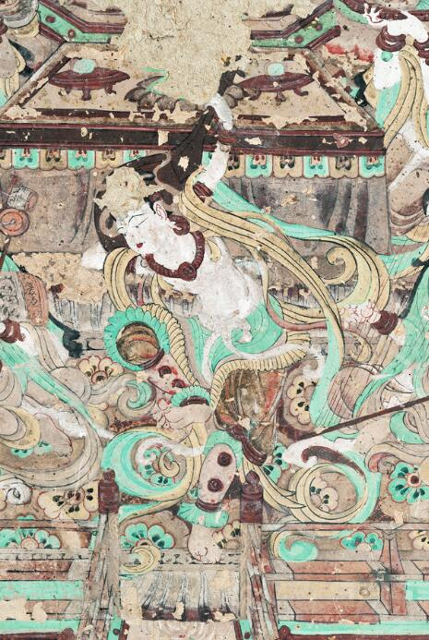
3. Data Process & Result——Dataset
Dunhuang Grottoes Content Catalogue, including detailed information for all 492 caves. All have been structured and stored in knowledge graph.
Dictionary of Dunhuangnology, including 6,925 entries of Dunhuang manuscripts and academic studies under 60+ categories.
Academic literatures of Dunhuang research. 7,929 e-books, 557GB. 5,083 papers, 784 of them have been textualized.
Hongyu Wang , School of Information Management , Wuhan University
11
Notes:
敦煌石窟内容总录，包含全部492个洞窟的详细内容介绍。已完成结构化处理，转化为了知识图谱。
敦煌大辞典，包含敦煌遗书及学术研究中60余类6925条词条，共164万字，并以此构造了敦煌词表。
敦煌研究文献，7929本电子书，557GB。5083篇论文，已文本化处理了784篇。

Slide 12
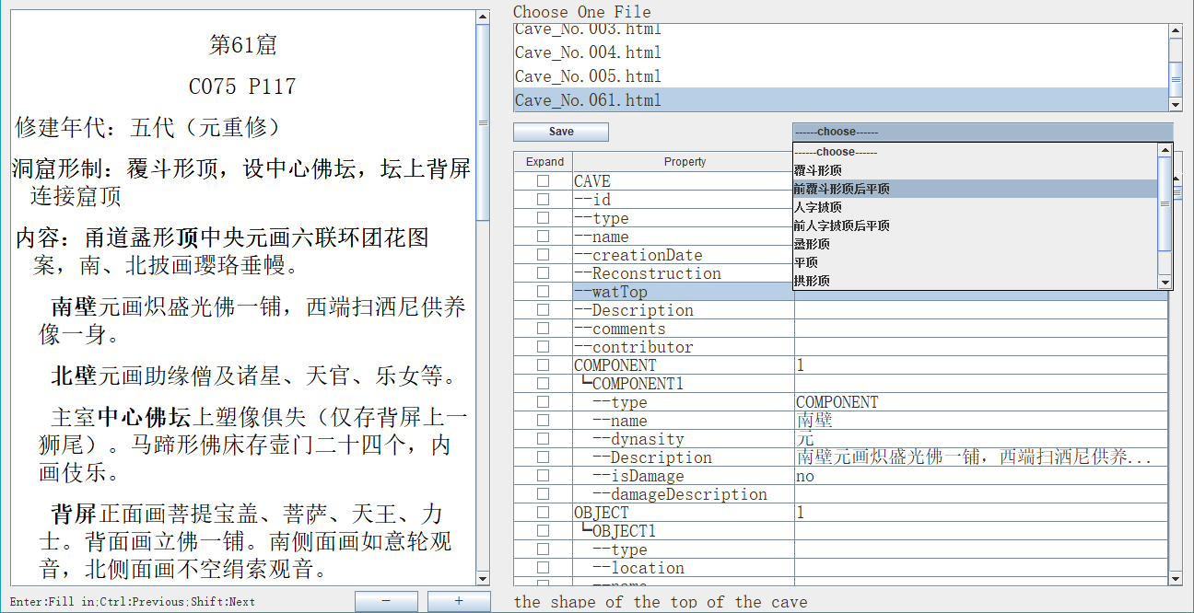
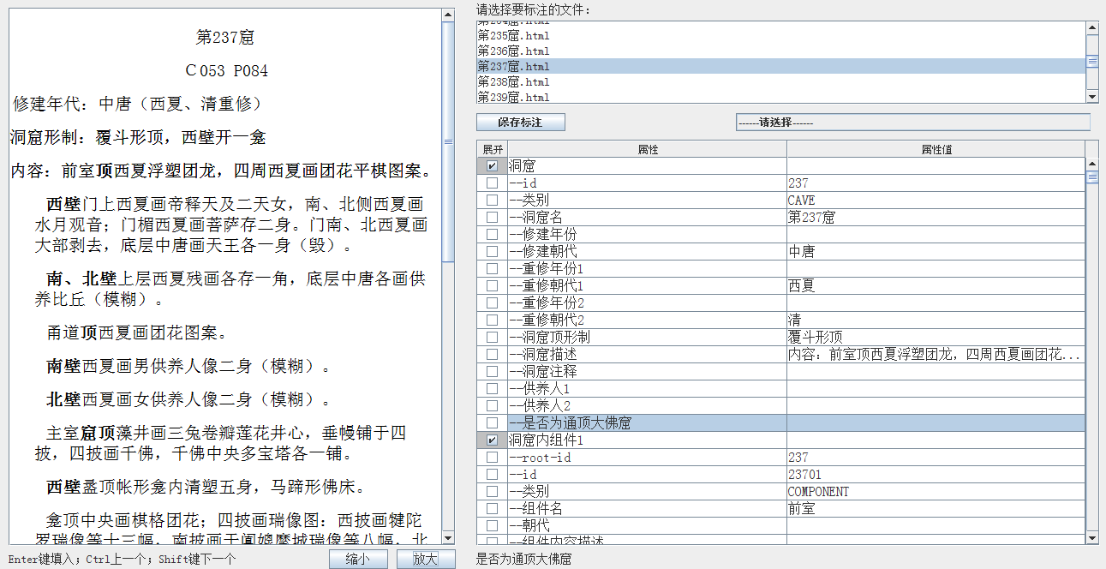
3. Data Process & Result——TDSAT
We developed the Text Deep Semantic Annotation Tool based on the proposed KO model to annotate the text of Dunhuang Grottoes and construct the Knowledge Graph for all 492 grottoes.
Then, we stored these data into the Neo4j after data-structuring.
With the aid of this tool, three types entities and their relationships are extracted, and their attributes are annotated, which realized the knowledge organization and semantic association of Dunhuang digital resources in the form of attribute graph.
Hongyu Wang , School of Information Management , Wuhan University
12
Notes:
基于提出的知识组织模型，我们开发了文本细粒度语义标注工具，对敦煌石窟有关的文本内容进行了标注，并完成了全部492个洞窟的知识图谱构建。经过结构化处理，这些数据被存入Neo4j。
通过该工具，提取了敦煌石窟中三种类型的实体及其关系，并对它们的属性进行了标注，以属性图的形式实现了敦煌石窟的知识组织和语义关联。

Slide 13
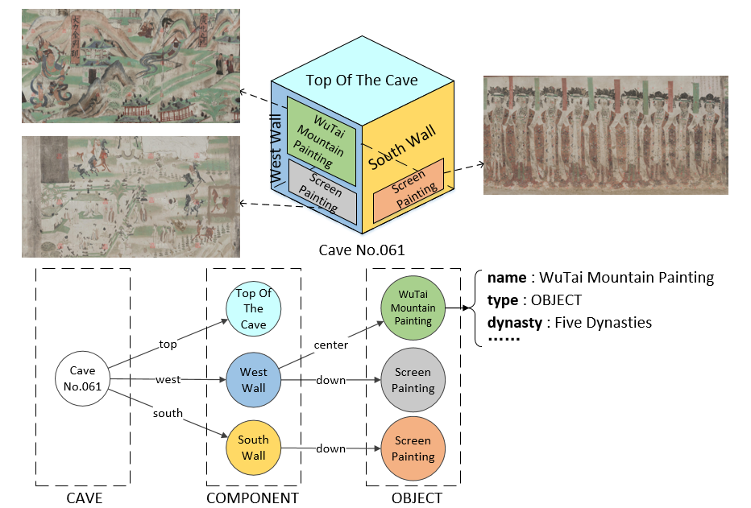
3. Data Process & Result——Example
As a step further, the relevant multi-media resource are stored together with these knowledge in Neo4j.
Taking Grotto No.61 for example, the contents of its west and south wall are extracted according to the Dunhuang Grottoes KO Model, as shown in Figure.
Hongyu Wang , School of Information Management , Wuhan University
13
Notes:
进一步地，将这些知识及相关的多媒体资源一并存储到属性图数据库neo4j中。
以敦煌61窟为例，根据敦煌石窟知识组织模型对其西壁和南壁的内容进行抽取，结果如图所示。

Slide 14
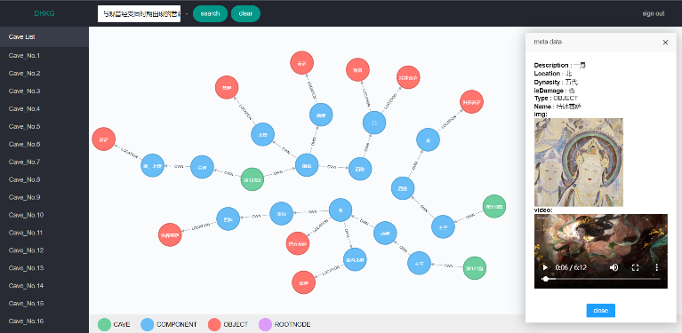
3. Data Process & Result——Result
The platform built in this paper with its function of knowledge navigation and semantic retrieval in Dunhuang Grottoes, can be applied to assist in further Studies.
For example, if the query of "Bodhisattvas appearing at the same time as the Avalokitesvara Sutra" is input, the answer will show all the suitable bodhisattvas with their knowledge networks' structure, metadata, and associated multimedia resources such as photos and videos. This result has shown in figure.
Hongyu Wang , School of Information Management , Wuhan University
14
Notes:
本文中搭建的敦煌石窟知识图谱平台，提供了知识导航和语义检索，可以辅助敦煌学研究的深入开展。
例如，如果查询是“与观音经变同时期出现的菩萨”，结果将展示所有合格的菩萨，及关联的图片、视频等多媒体资源。如图所示。

Slide 15
04
Conclusion & Future Work
PART FOUR

Slide 16
4. Conclusion & Future Work
Conclusion
Using Dunhuang Grottoes as example, this paper illustrates the process of attribute graph model-based knowledge organization and revelation of digital resources of cultural heritage.
Attribute graph model enables an handy and efficient semantic organization of entities in cultural heritage knowledge, their relationships and attributes, which further enables a fine-grained analysis and revelation of cultural heritage.
This paper provides another perspective for the organization of digital resources and the revelation of their cultural connotations. In addition, it provides a flexible way to consider the infrastructure development in digital humanities.
Future Work
In the following, the research will attempt to further standardize the metadata of Dunhuang Grottoes on the basis of international standards such as CDWA, CIDOC-CRM, etc., and work towards the associated release and sharing of datasets.
Hongyu Wang , School of Information Management , Wuhan University
16
Notes:
本文以敦煌石窟为例，展示了基于属性图模型对文化遗产数字资源进行知识组织与揭示的过程。
属性图模型可以便捷、有效地对文化遗产知识中的实体、关系及它们的属性进行语义化地组织，从而实现文化遗产知识的细粒度分析与揭示。
本文为文化遗产数字资源的知识组织和文化内涵揭示提供了一种新的视角。
今后，本研究将基于CDWA、CIDOC-CRM等国际标准对敦煌洞窟的元数据进一步地规范，并实现所建设数据集的关联发布与公开共享。

Slide 17
Wuhan
University
THANK YOU
For Your Listening !
Hongyu Wang

